Slide 1
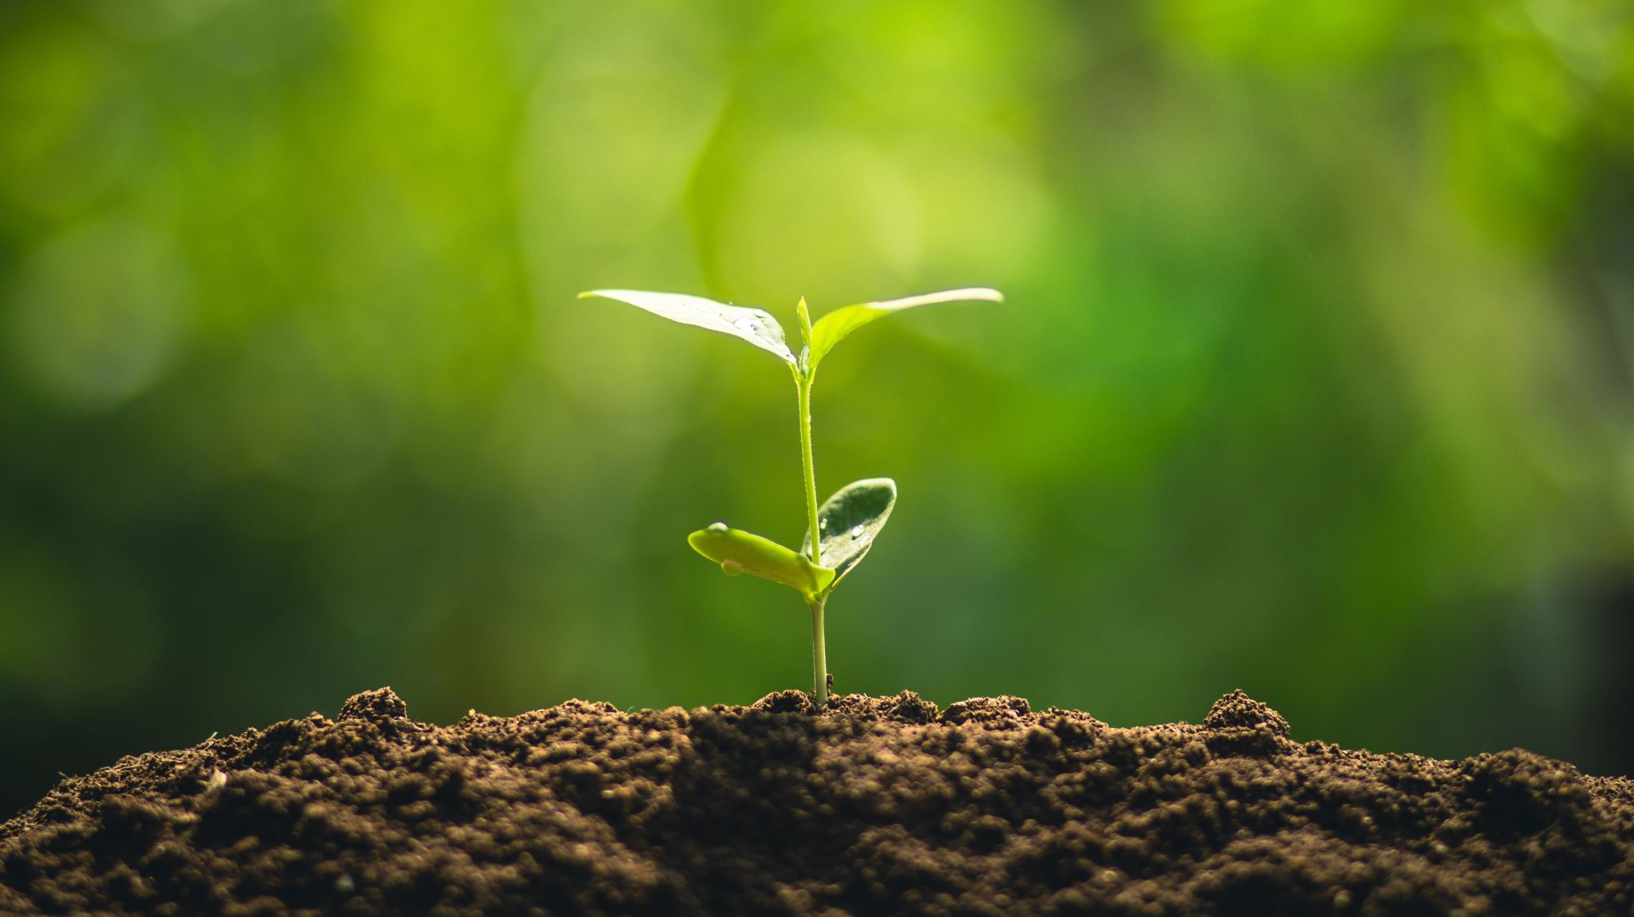
It’s Time to Plant: There’s a Blessing in the Seed
Sis. Andrea M. Moore
Labor Day Lectureship 2025
McAlmont Church of Christ
All text is taken from NIV unless otherwise indicated.

Slide 2
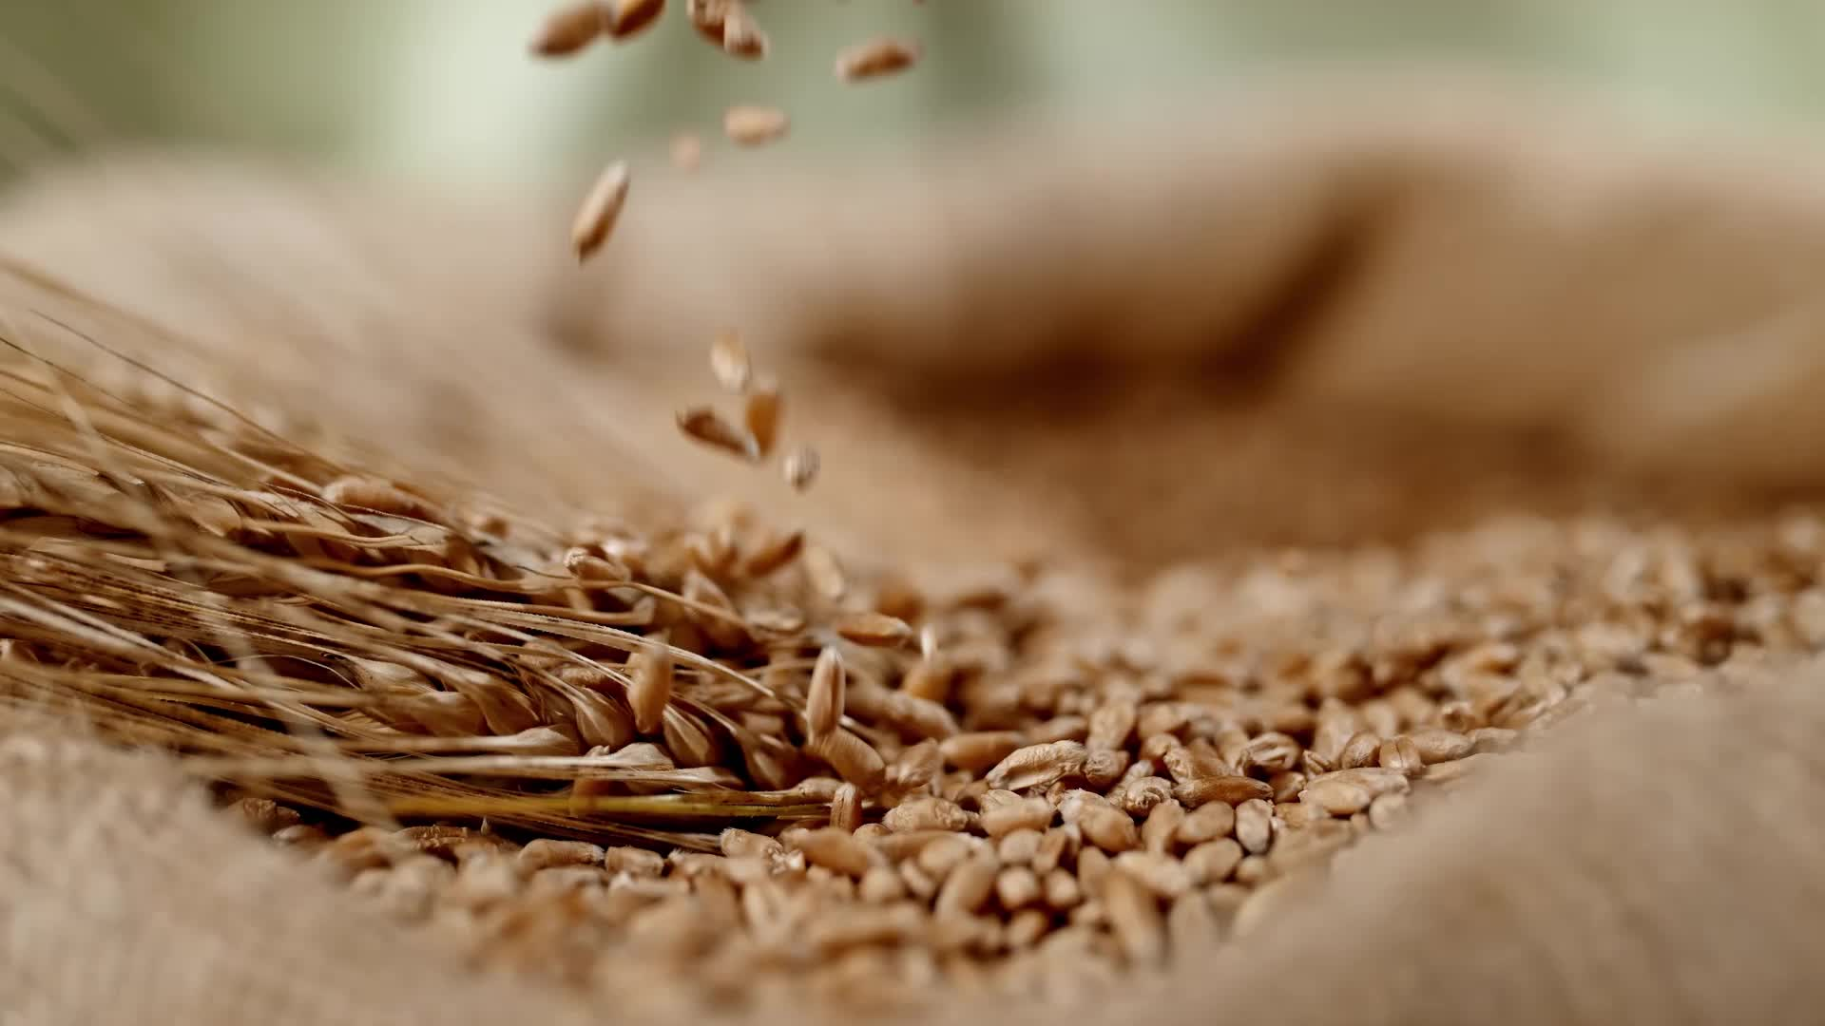
Every living thing God made was created containing the “seed” needed to reproduce “after his kind.”

Slide 3
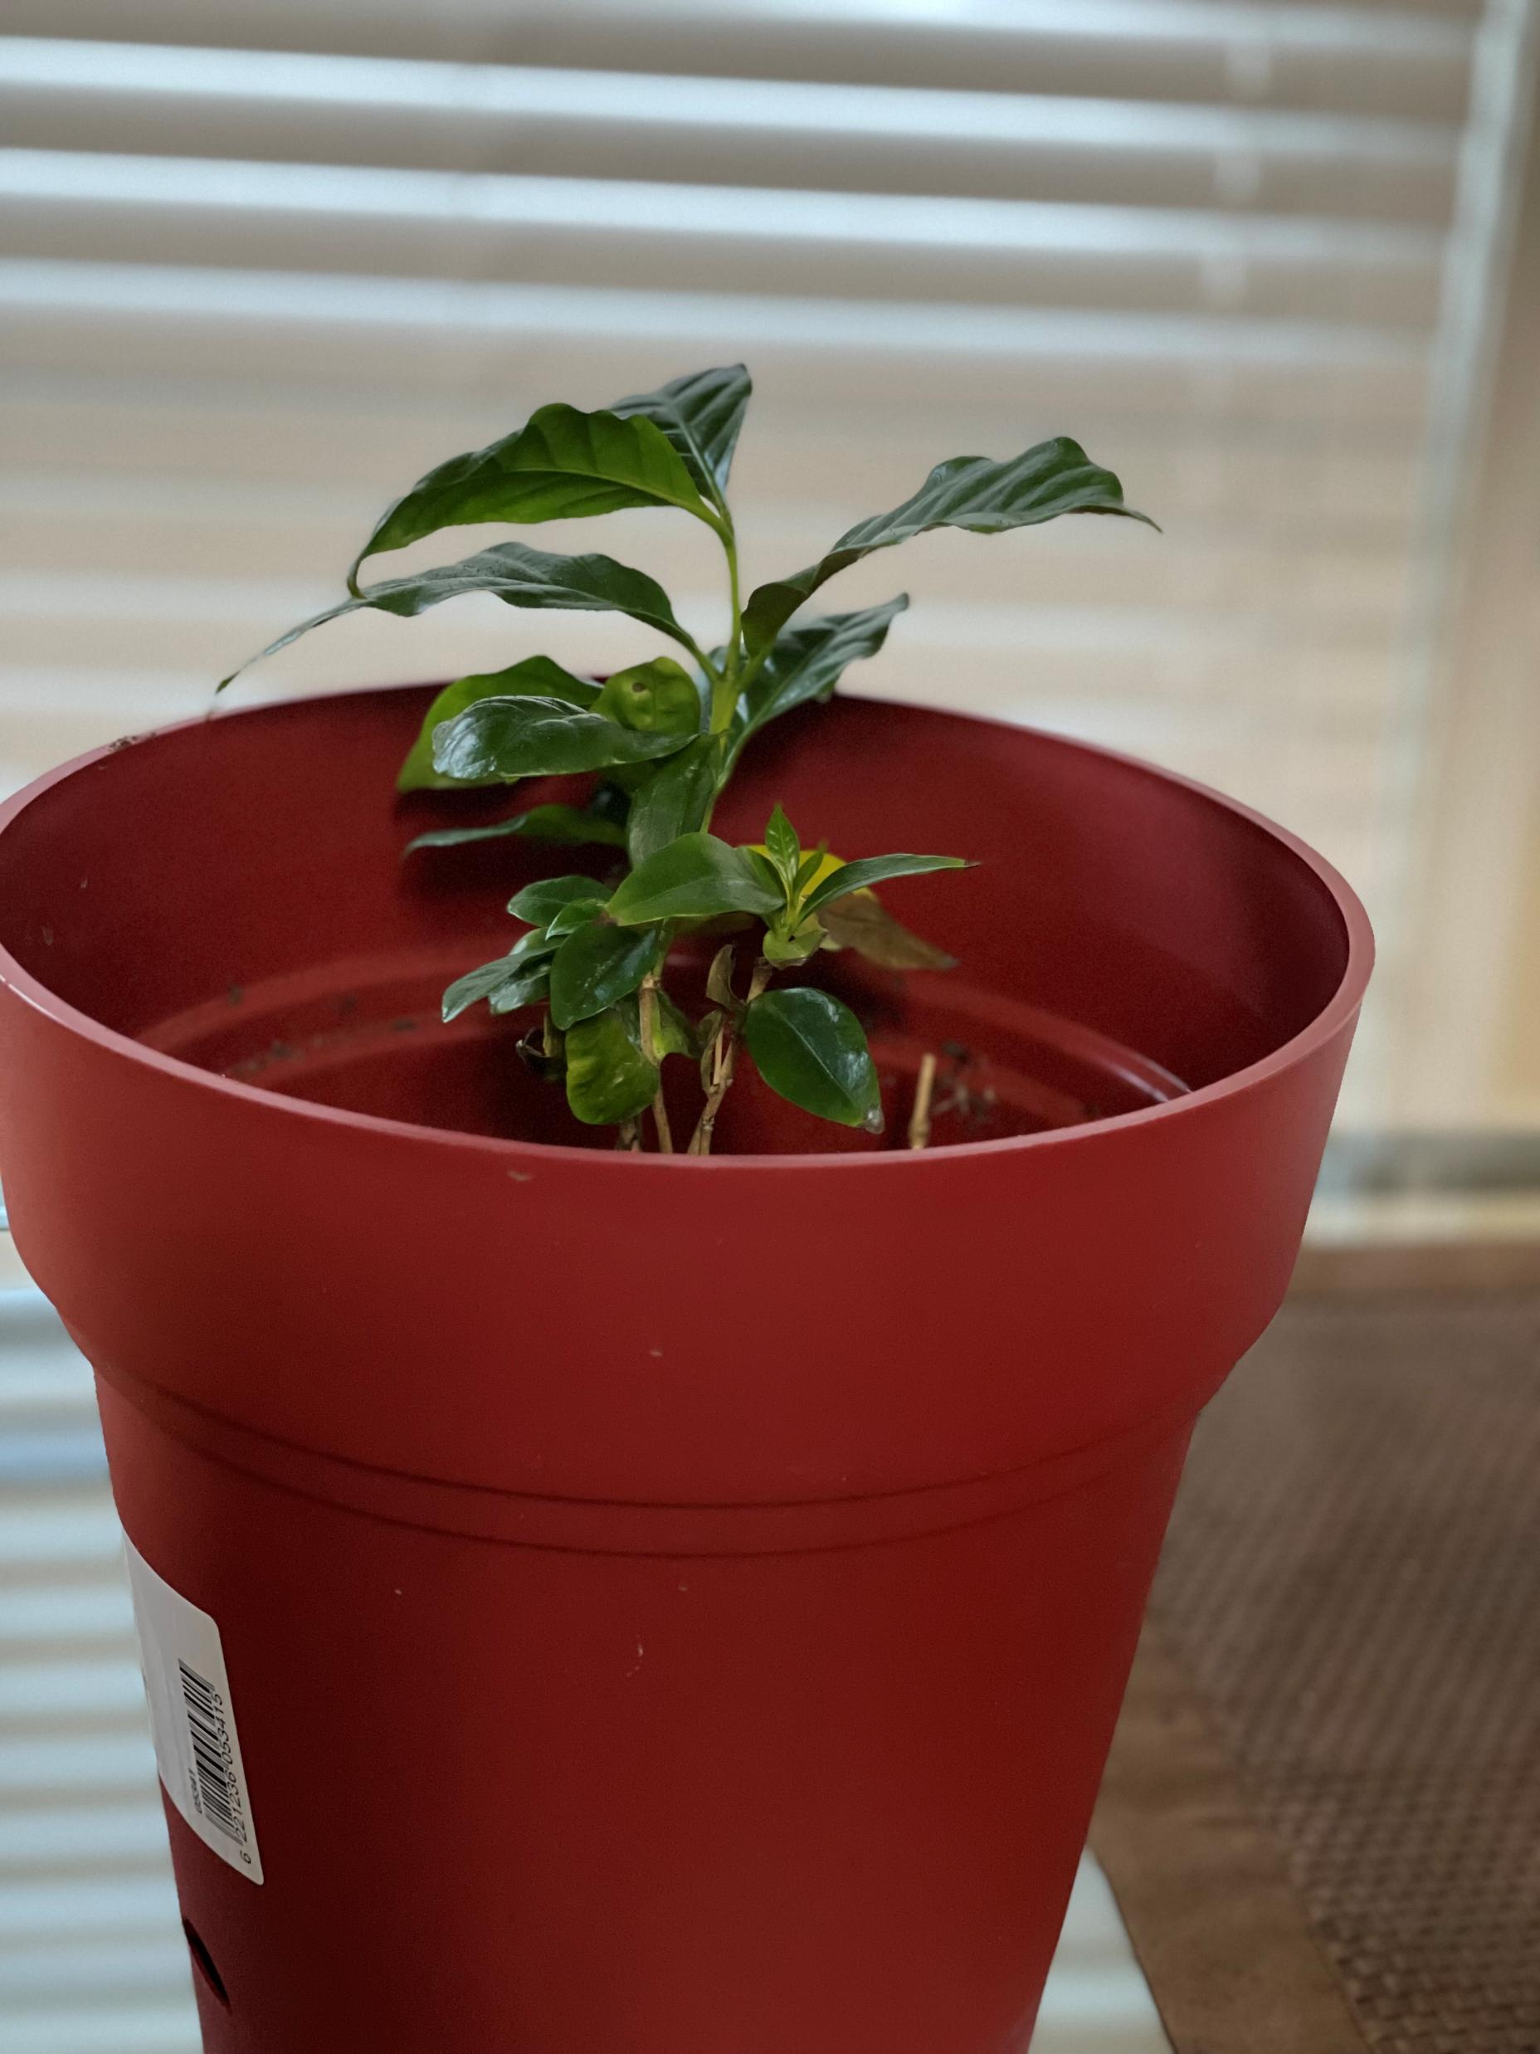
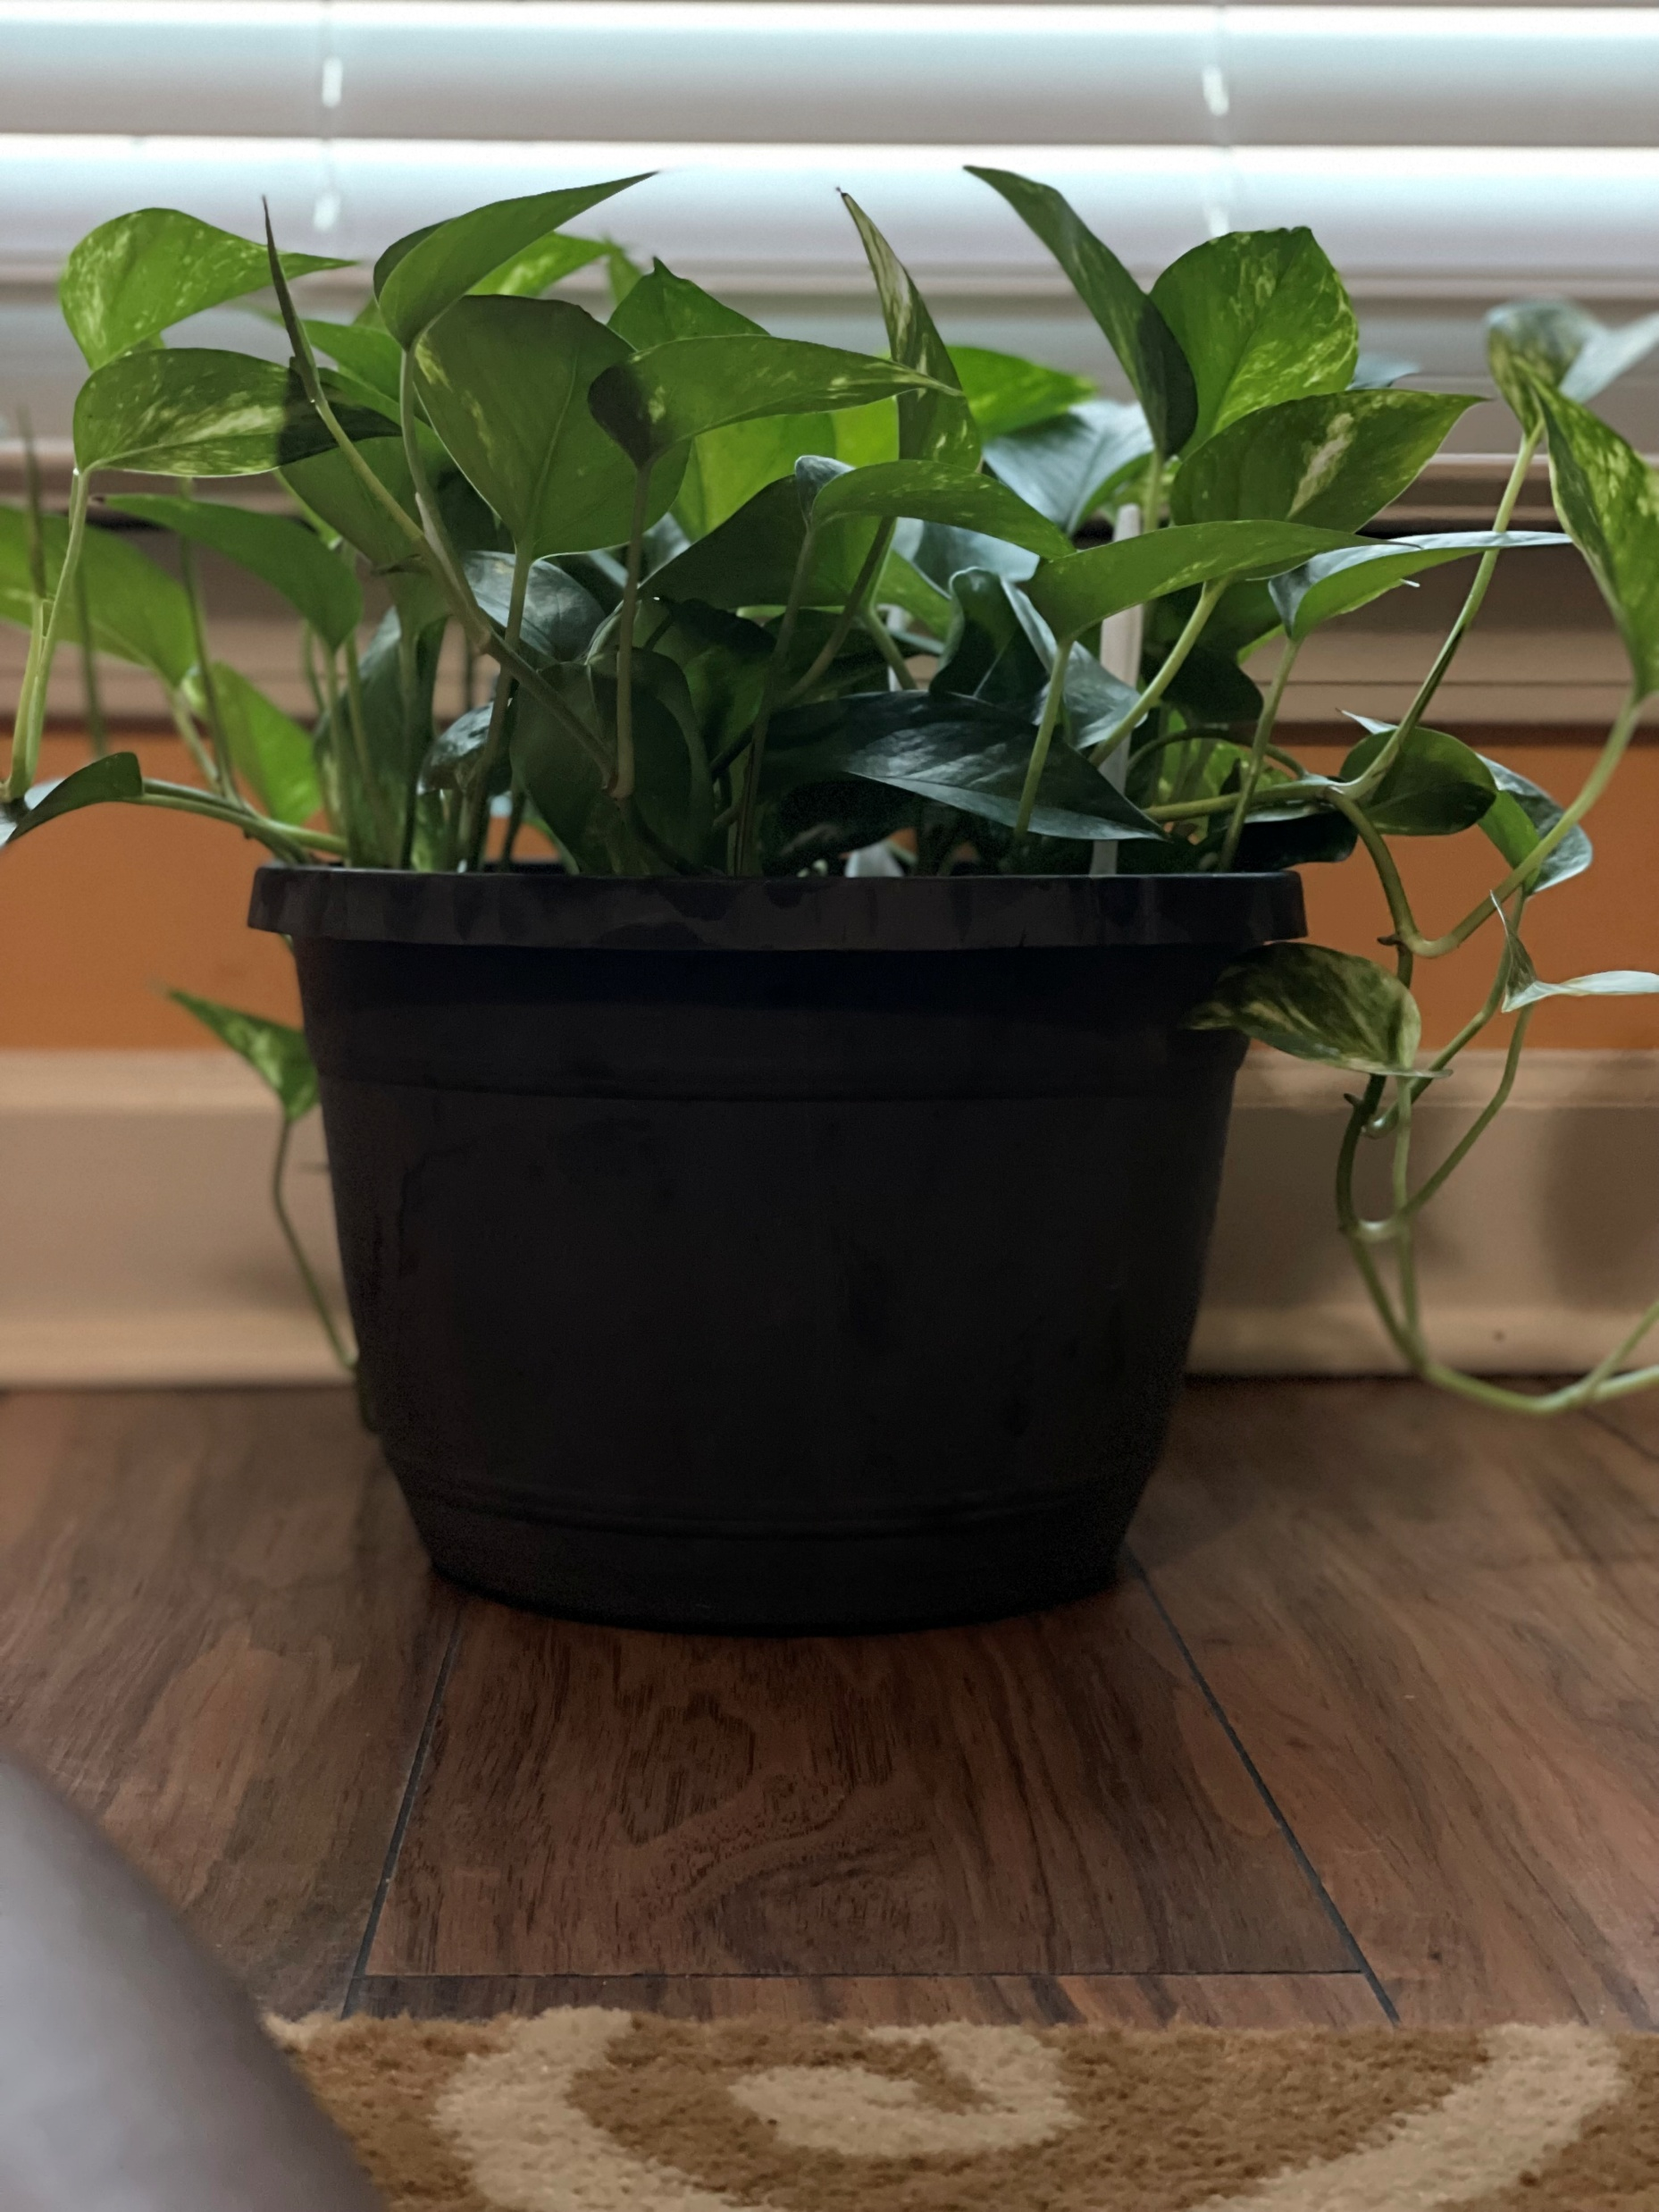
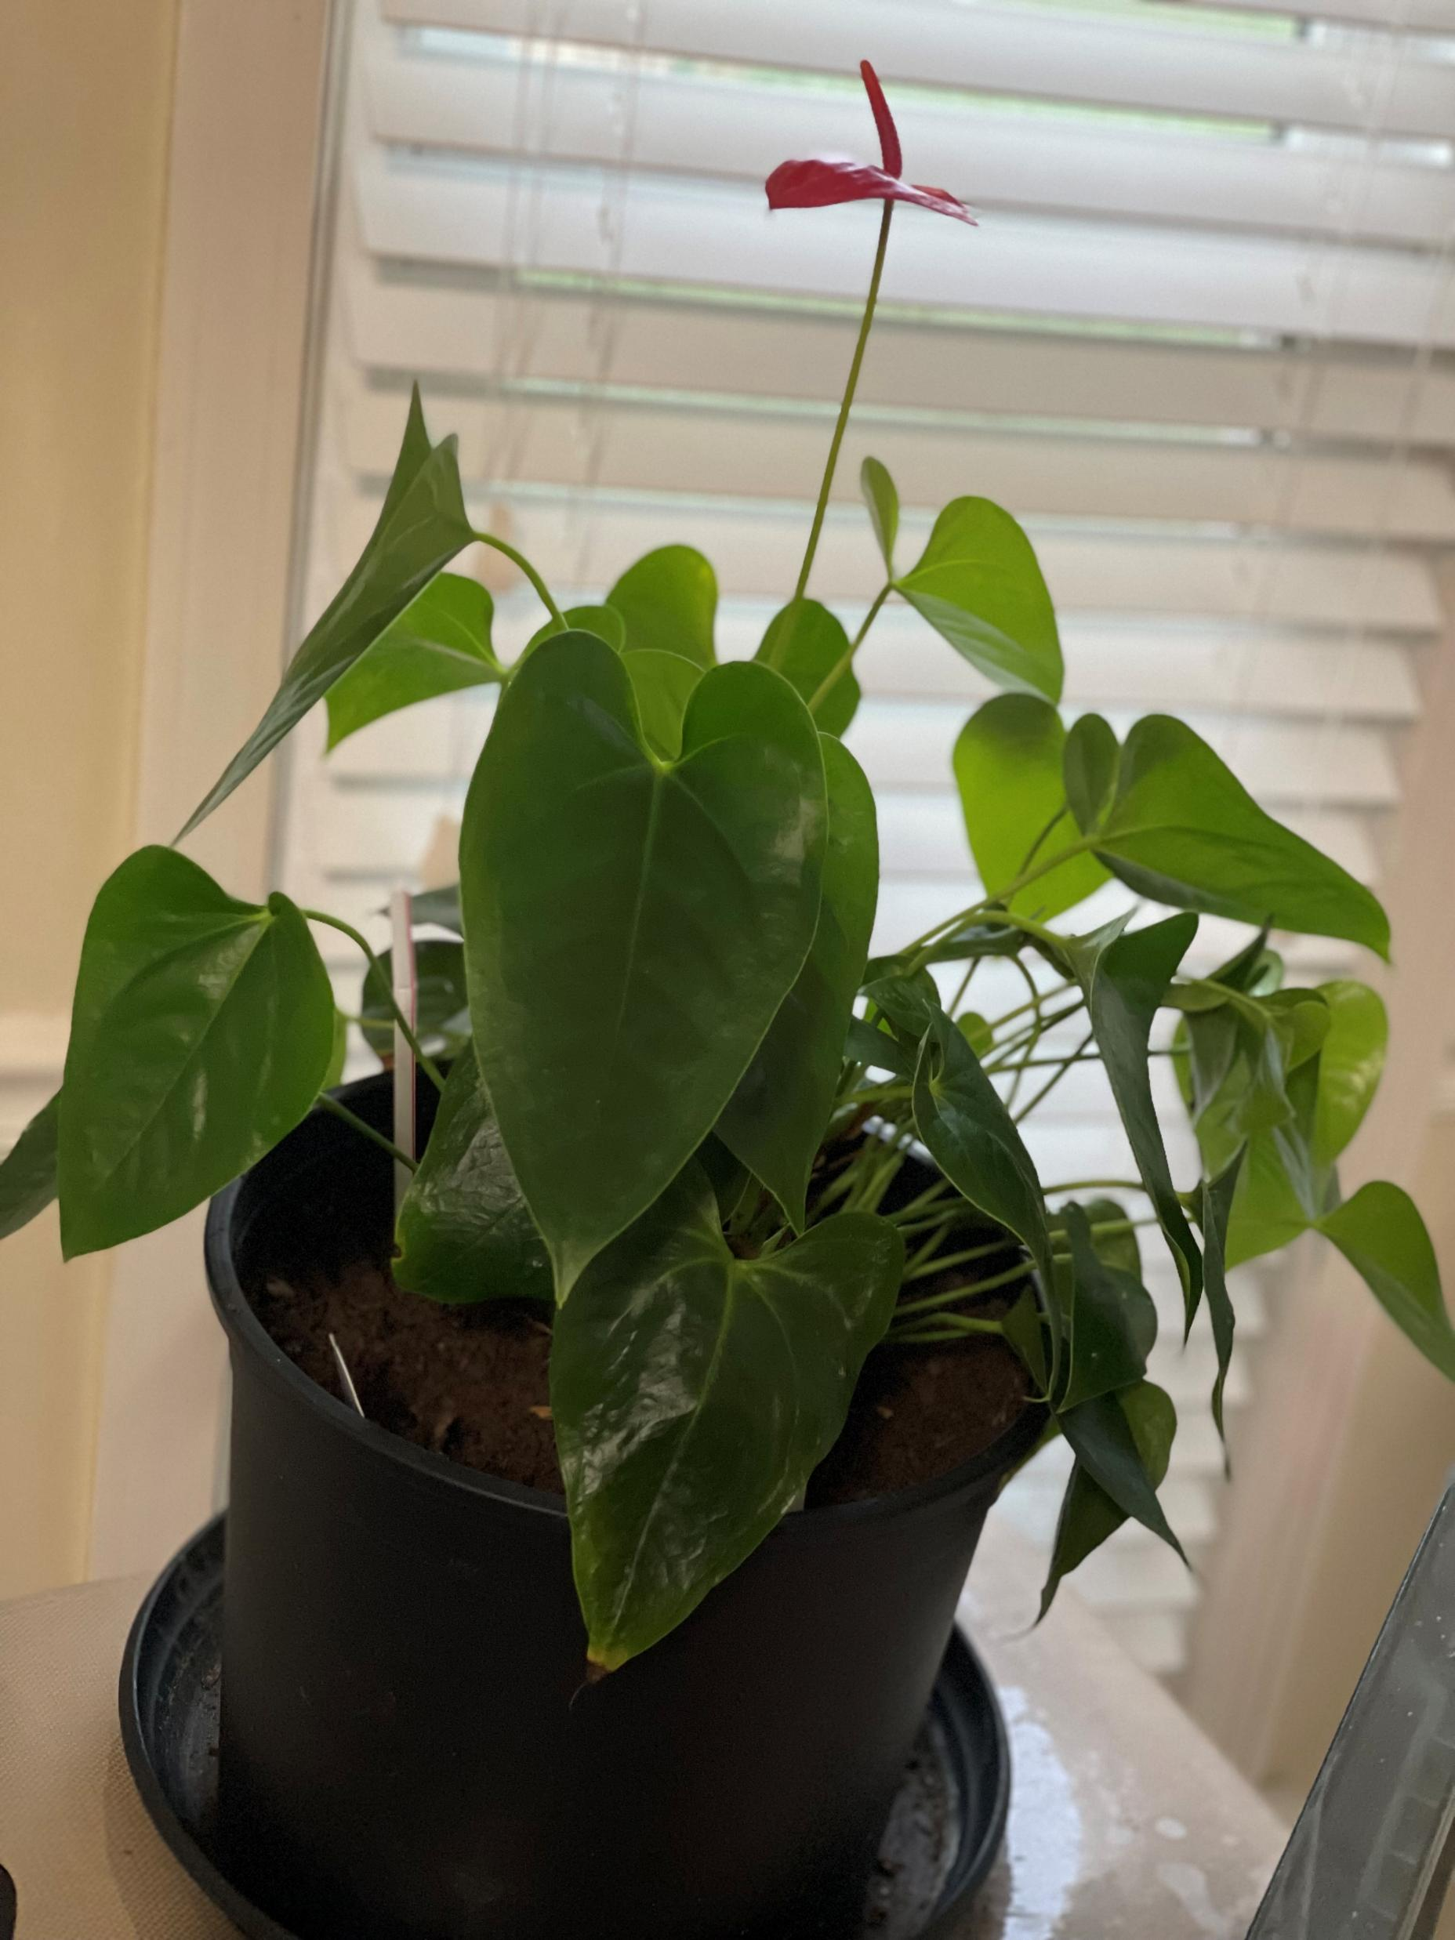

Slide 4

Galatians 3:16, 29
¹⁶ The promises were spoken to Abraham and to his seed. Scripture does not say “and to seeds,” meaning many people, but “and to your seed,”^{[a]} meaning one person, who is Christ.
²⁹ If you belong to Christ, then you are Abraham’s seed, and heirs according to the promise.

Slide 5
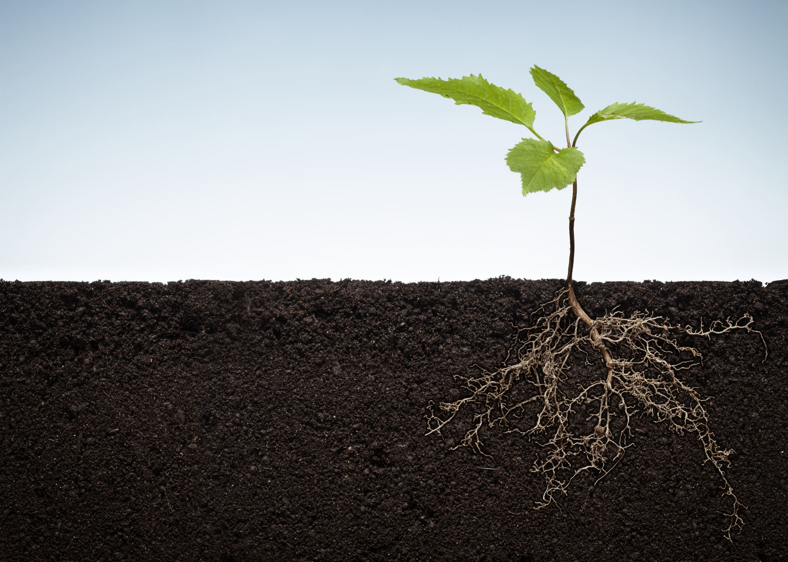
What is your soil?

Slide 6
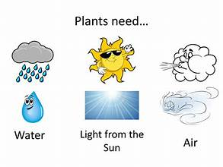
Water + Air + Sunlight
  Water = Word of God
  Air = God breathed
  Son = Son of God (Jesus)

Slide 7
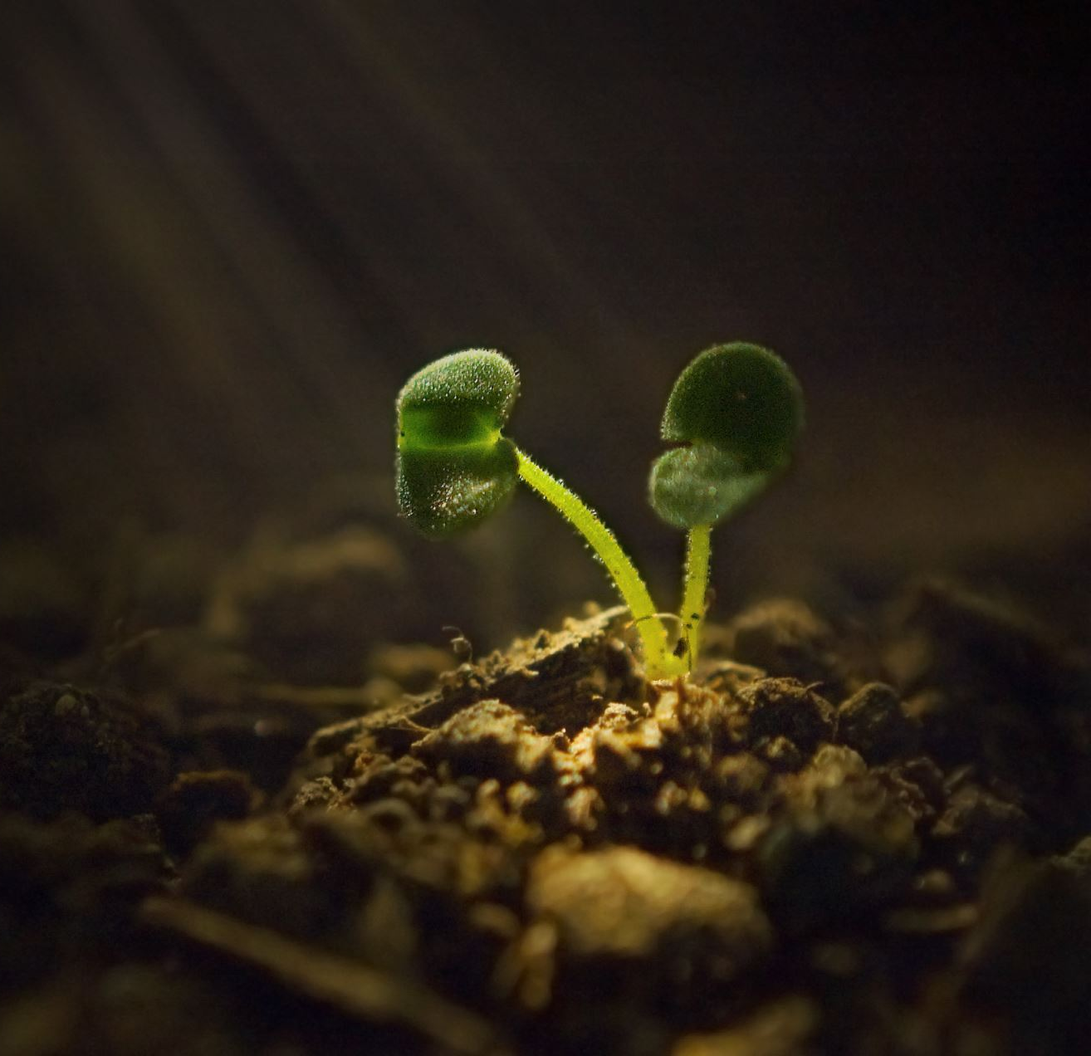
PLANT. WATER. GROW.
I Corinthians 3:6 - ⁶ I planted the seed, Apollos watered it, but God has been making it grow.

Slide 8


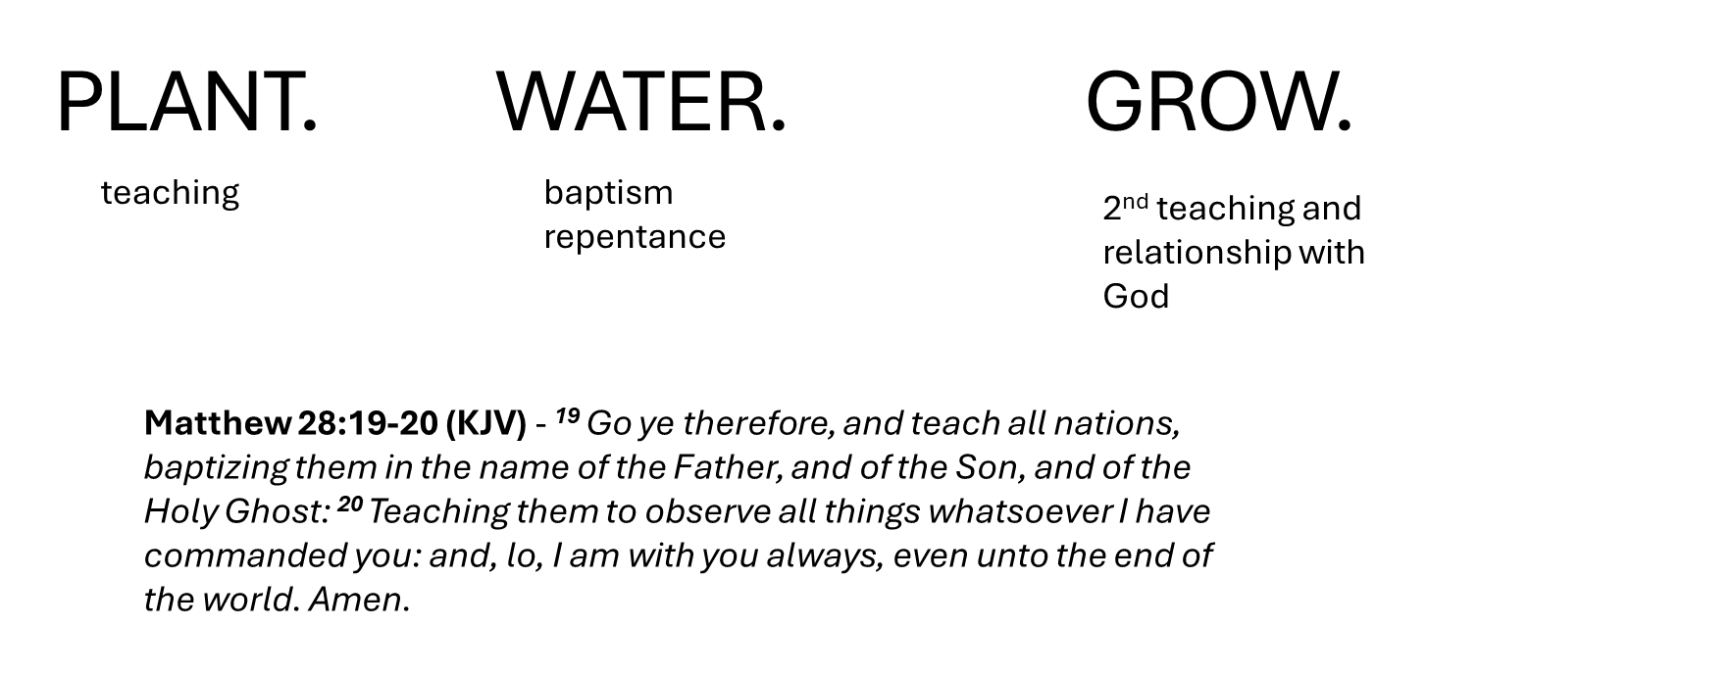


Slide 9

PLANT
How comfortable are you with planting?

Slide 10
PLANT
WATER

Slide 11


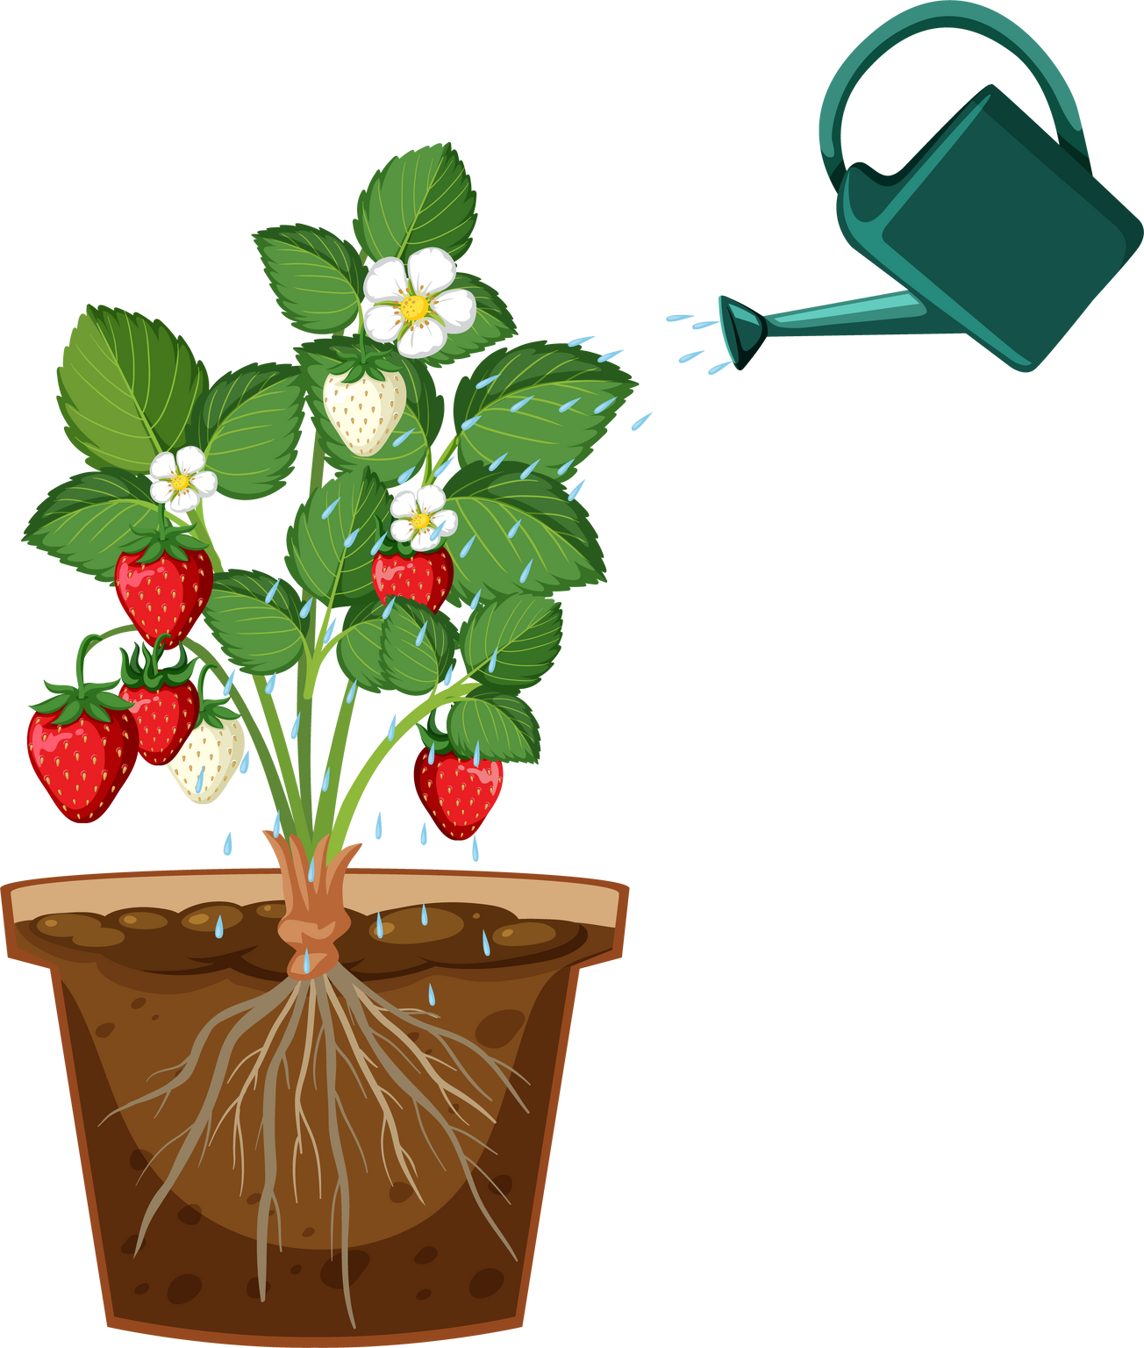

John 4:28-29 - 28 Then, leaving her water jar, the woman went back to the town and said to the people, 29 “Come, see a man who told me everything I ever did. Could this be the Messiah?”
Ephesians 5:29 After all, no one ever hated their own body, but they feed and care for their body, just as Christ does the church—
• How do you keep yourself watered?
• Get to the root!

Slide 12
PLANT
WATER
How comfortable are you with watering another? Who waters you?

Slide 13

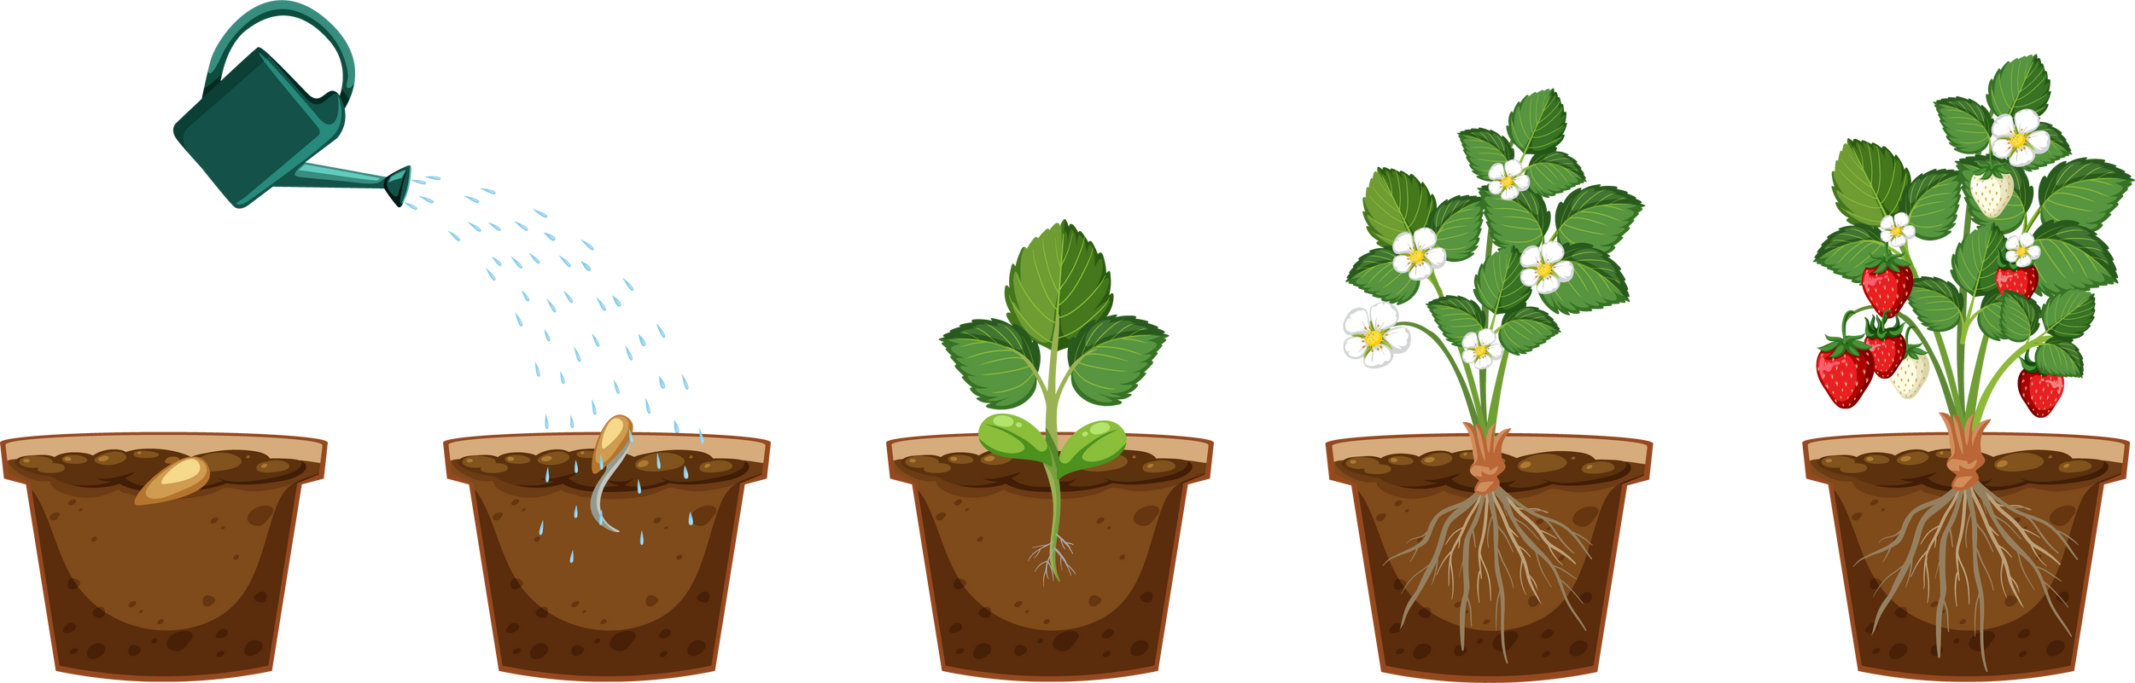
I Corinthians 3:6-9 - 6 I planted the seed, Apollos watered it, but God has been making it grow. 7 So neither the one who plants nor the one who waters is anything, but only God, who makes things grow. 8 The one who plants and the one who waters have one purpose, and they will each be rewarded according to their own labor. 9 For we are co-workers in God’s service; you are God’s field, God’s building.

Slide 14
GROW
PLANT
WATER

Slide 15
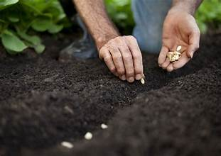
“A seed neither fears light nor darkness, but uses both to grow.” ― Matshona Dhliwayo
“A seed houses generation of seeds and can also feed generations of man.” ― Oscar Bimpong

Slide 16
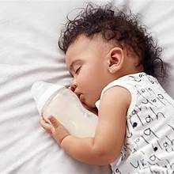
I Peter 2:2 (KJV)
² As newborn babes, desire the sincere milk of the word, that ye may grow thereby:
Growth is progressive.

Slide 17
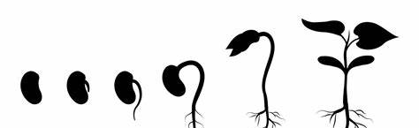
GROW IN…. (JAMES 1)
How you see and identify yourself (James 1:1, 27)
The way you look at suffering and trials (James 1:2-4)
Faith so you automatically pray to God daily (James 1:5-8)
Proper perspective of life with humility (James 1:9-11)
Seeing God as a good Father that is helping you. (James 1:12-18)
Appreciation for the strength and challenge of scripture (James 1:19-21)
Urgency in putting into action what you read (James 1:22-24)
Connecting religion with the real world (James 1:25-27)

Slide 18
GROW
PLANT
WATER
How comfortable are you with growth?

Slide 19

Psalm 1:1-3
Blessed is the one who does not walk in step with the wicked or stand in the way that sinners take or sit in the company of mockers, 2 but whose delight is in the law of the Lord, and who meditates on his law day and night. 3 That person is like a tree planted by streams of water, which yields its fruit in season and whose leaf does not wither— whatever they do prospers.
Luke 17:6
6 He replied, “If you have faith as small as a mustard seed, you can say to this mulberry tree, ‘Be uprooted and planted in the sea,’ and it will obey you.
Isaiah 53:10
10 Yet it pleased the Lord to bruise him; he hath put him to grief: when thou shalt make his soul an offering for sin, he shall see his seed, he shall prolong his days, and the pleasure of the Lord shall prosper in his hand.

Slide 20
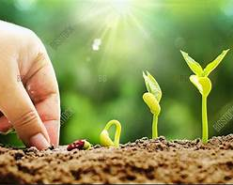
Zechariah 8:12-13
KJV - ¹² For the seed shall be prosperous; the vine shall give her fruit, and the ground shall give her increase, and the heavens shall give their dew; and I will cause the remnant of this people to possess all these things. ¹³ And it shall come to pass, that as ye were a curse among the heathen, O house of Judah, and house of Israel; so will I save you, and ye shall be a blessing: fear not, but let your hands be strong.
NLT - ¹² For I am planting seeds of peace and prosperity among you. The grapevines will be heavy with fruit. The earth will produce its crops, and the heavens will release the dew. Once more I will cause the remnant in Judah and Israel to inherit these blessings. ¹³ Among the other nations, Judah and Israel became symbols of a cursed nation. But no longer! Now I will rescue you and make you both a symbol and a source of blessing. So don’t be afraid. Be strong, and get on with rebuilding the Temple!

Slide 21

Discussion Time!

Slide 22
What is your seed?
What‘s inside your seed?
What needs to be pruned?

Slide 23
https://www.youtube.com/watch?v=2LL3itgQff4

