Slide 1
Proper Care For Growth
Men’s Session / Labor Day Lectureship
Jeremiah 2:13-14
Dr. Artrell Harris, Minister
Roswell Church of Christ
Kansas City, Kansas

Slide 2

Is a continuous, lifelong, process where I partner with God and allow the Holy Spirit to guide and direct my actions and thinking.

Slide 3
Toyota Growth Model
Kaizen vs Muda
___________________________
Kaizen = Change for the better, Ongoing improvements, incremental improvements
Muda = Waste, uselessness

Slide 4

Pitch deck

Slide 5
It is easier to build strong children than to fix broken men – Fredrick Douglass

Slide 6
Possible Problems That Hinder Spiritual Growth In Men
No Need For It: They do not see it as useful. Religion is soft. It is not masculine. It can’t help my problems
Identity Issues: Men gain identity from a sense of purpose, doing, worldly success, income, status. We seek to conquer and when we miss the mark we feel unworthy.
Fatherhood Wound: This is deep tissue stuff, if you did not have a father growing up or if your father was abusive, or “Papa Was A Rolling Stone.” This creates trust issues with God.
Pride/Self-Reliance: This is a self-centered life vs a God-centric life. Ego says, I have it all together and I don’t need what that offers
Isolation: We struggle with accountability. I need to be in community and have the support of strong men, but I feel I may not measure up.

Slide 7
Out of Control Life / Sin Issues: Men face extreme temptations and we fall repeatedly and daily. We feel unworthy. We feel that Satan is winning battle in “Spiritual Warfare.” We give up and quit trying.
Trust Issues: I don’t trust no man to lead me. I will lead myself. Where was God when we were struggling? Where was God when I lost my job? Where was God when my wife left?
Hypocrisy Factor: They sin just like I do. They are all crooks. They have “Church Hurt” because they saw church people say and do unholy things.

Slide 8

Growth Area & Opportunities – Romans 12:1-2

Slide 9

Pray & Reach Out To God – 1 Thessalonians 5:17
Surrender – This is where I surrender my will, my plans, ways, and faults for God to override my thinking – Luke 9:23
Find a Spiritual Mentor – Paul & Timothy / Elijah & Elisha
Participate in a Men’s Group – This is where I can be honest about struggles. I will also see and hear about the struggles of others.

Slide 10
How to Grow….
Study Daily: This is food for the soul. I desire more of His word. Set a time to study – 2 Timothy 2:15
Quit Trippin / Playing & Trying to Manipulate: Lets get honest with God and ask Him to rule and reign in our lives. Pray that God will heal your brokenness.
Worship: Attend worship services to grow and gain. The Lord will recognize and reward your faithfulness.
Serve: Be a part of ministries. Use your spiritual gifts
Quiet Time With God: This is where I study, pray, meditate, confess and repent. It is where I grow closer to God

Slide 11

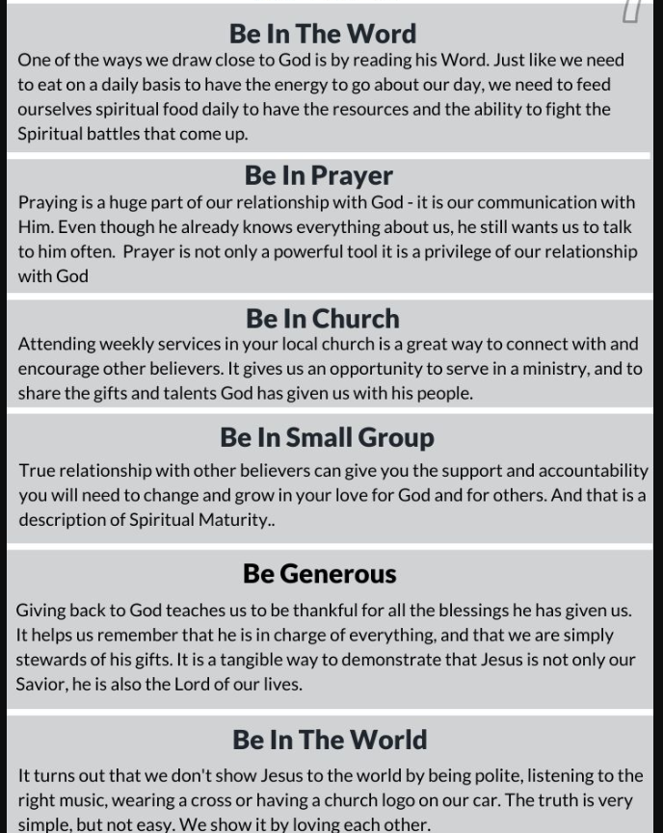
Growth Strategy
Just Do It….
Stop Making Excuses…..
Get A Plan….
Be Intentional…..
Get Accountable…..
Ask God To Deliver, Keep and Free You On The Continual……

Slide 12

Churches Can Do More To Help…..
Start Life Groups
Create Opportunities To Serve
Have Manly Outings / Do Manly Things
Develop A Men’s Ministry
Develop Them / Look For Them / Identify Them / Encourage Them

Slide 13
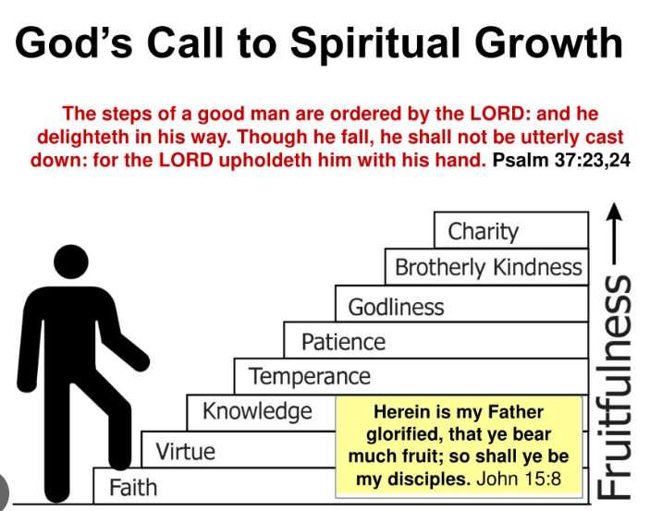
Daily Growth
Take Baby Steps, Crawl, Walk, Run

Slide 14

Our competition is……
Satan
The Identity Religions (Hebrew Israelites, Muslims, Egyptology)
The World
NFL Football On Sunday
Our Own Traditions & Egos

Slide 15
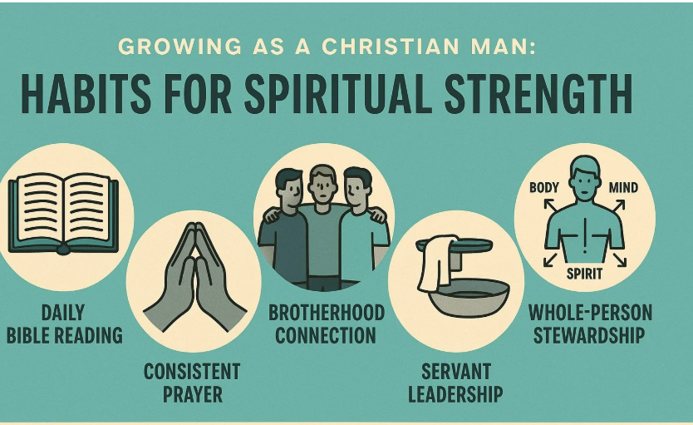
Spiritual Disciplines….

Slide 16
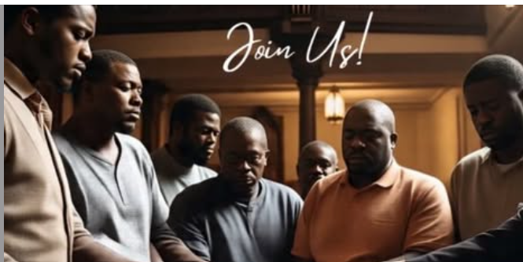
I Can Do More To Help
Reach out to men
Build a relationship
Listen to them
Text them
Mentor them
Be there through tough times

Slide 17

Develop The Next Generation

Slide 18
Thank you
Dr. Artrell Harris
Minister, Roswell Church of Christ
Kansas City, Kansas
servantforhim8@gmail.com

